Slide 1


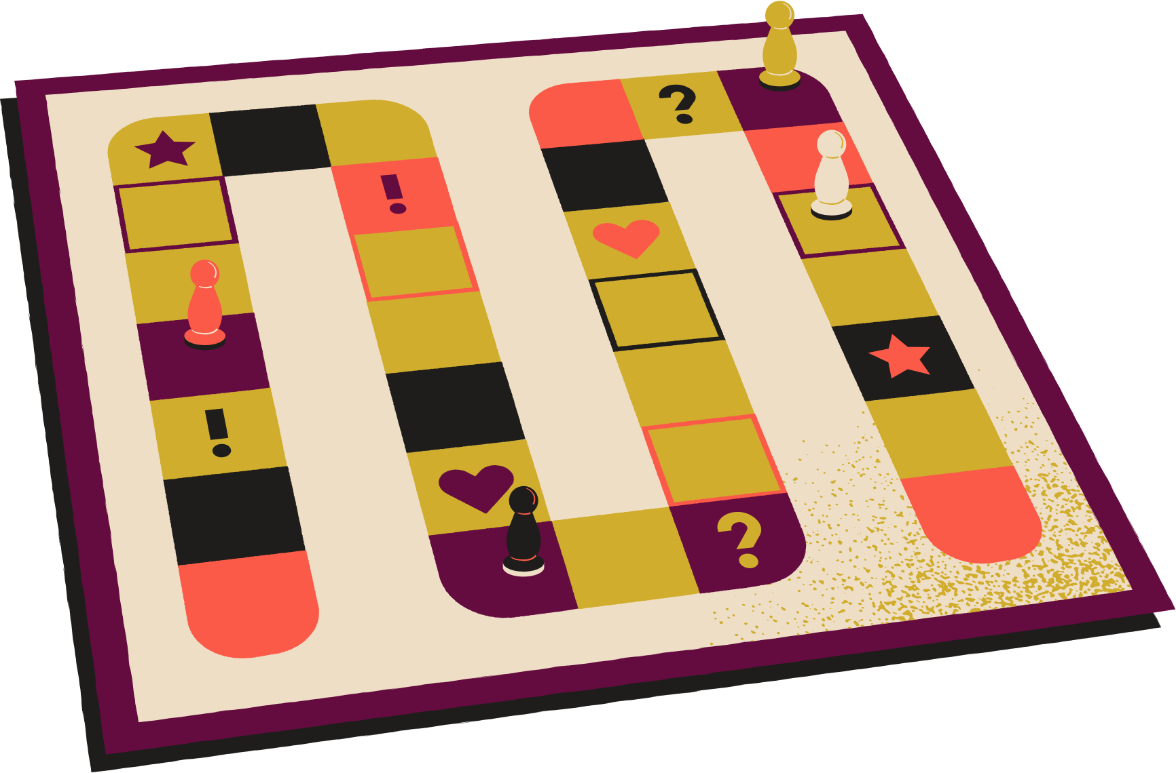
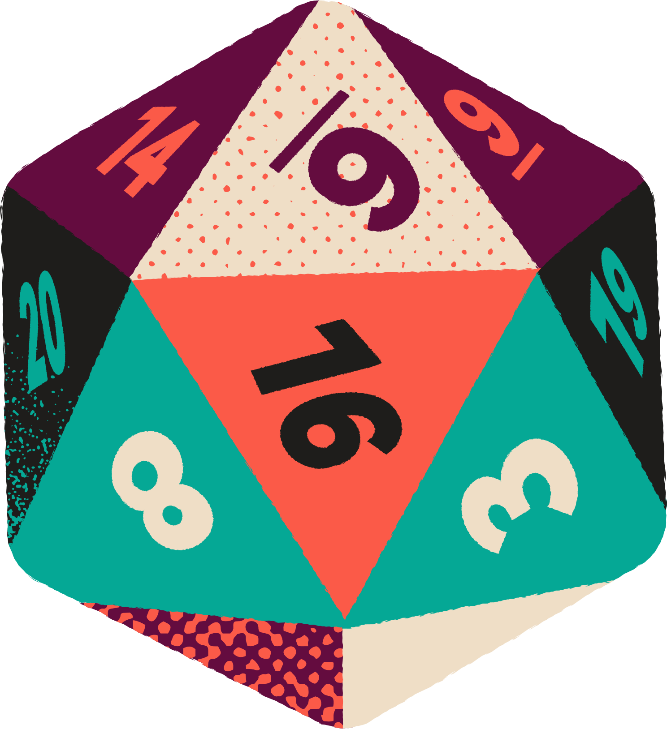
BoredGames
ADVANCED DATABASE
Groupe : Camille DOMMERGUE, Nissanth NADARASSIN, Harish Arvind SELVAKUMAR

Slide 2

Summary
1 - Bored Game
2 - Our Database
3 - The Website

Slide 3

Project description
Bored Game is a website catalog for various board games. The board game library web application serves as a centralized platform for board game enthusiasts to explore, track, and participate in board gaming events. It provides a catalog of board games, helps users manage their personal game collection, rate games and facilitates community engagement through event participation.
The target audience is a community of enthusiast board game collectors / players.

Slide 4
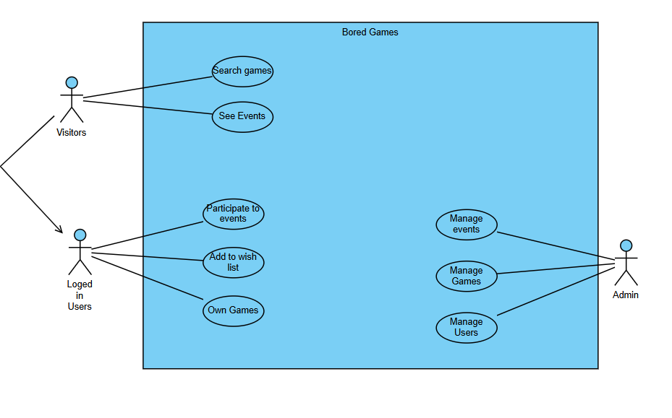
Use case diagram

Slide 5
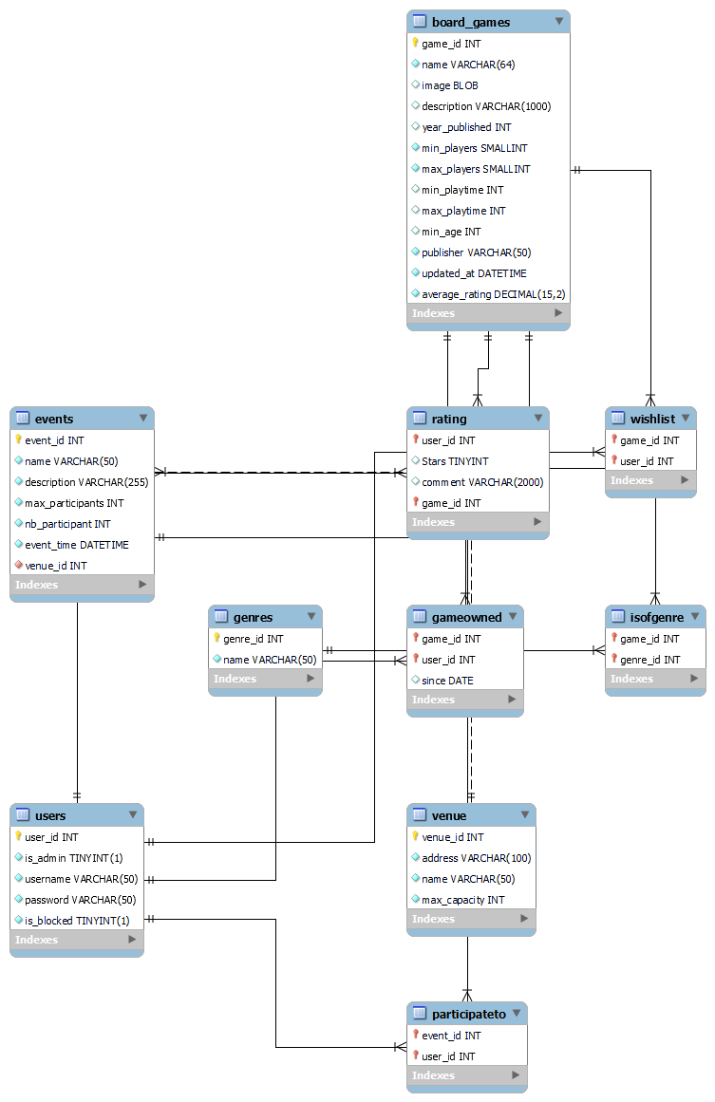

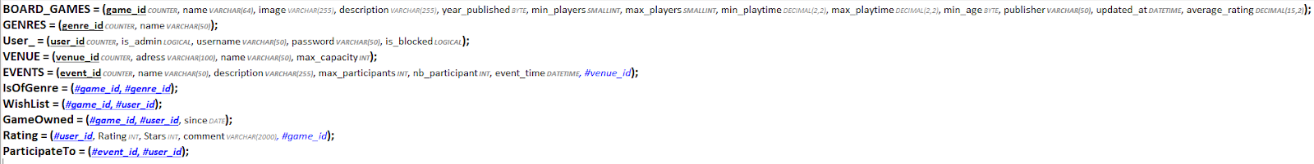
Database Used

Slide 6

Advanced featers - Views
-- A. Recently added 10 games
DROP VIEW IF EXISTS Recent_Games;
CREATE VIEW Recent_Games AS
SELECT * FROM BOARD_GAMES
ORDER BY updated_at DESC
LIMIT 10;
-- B. List of users for admin
DROP VIEW IF EXISTS Admin_UserList;
CREATE VIEW Admin_UserList AS
SELECT user_id, username, is_admin, is_blocked
FROM Users;
-- C. List of games for admin to manage
DROP VIEW IF EXISTS Admin_BoardGames;
CREATE VIEW Admin_BoardGames AS
SELECT game_id, name, year_published, min_players, max_players, average_rating
FROM BOARD_GAMES;
-- D. List of games owned and number of owners
DROP VIEW IF EXISTS Games_Owned_Count;
CREATE VIEW Games_Owned_Count AS
SELECT bg.name, COUNT(go.user_id) AS owners_count
FROM BOARD_GAMES bg
JOIN GameOwned go ON bg.game_id = go.game_id
GROUP BY bg.game_id;
GROUP BY g.genre_id;
-- E. Events and number of participants
DROP VIEW IF EXISTS Event_Participation;
CREATE VIEW Event_Participation AS
SELECT e.name, e.event_time, COUNT(p.user_id) AS participants
FROM EVENTS e
LEFT JOIN ParticipateTo p ON e.event_id = p.event_id
GROUP BY e.event_id;
-- F. Games and their genres
DROP VIEW IF EXISTS Game_Genres;
CREATE VIEW Game_Genres AS
SELECT bg.name AS game, g.name AS genre
FROM BOARD_GAMES bg
JOIN IsOfGenre ig ON bg.game_id = ig.game_id
JOIN GENRES g ON ig.genre_id = g.genre_id;
-- G. Genres and number of games in each
DROP VIEW IF EXISTS Genre_Game_Count;
CREATE VIEW Genre_Game_Count AS
SELECT g.name AS genre, COUNT(ig.game_id) AS total_games
FROM GENRES g
LEFT JOIN IsOfGenre ig ON g.genre_id = ig.genre_id

Slide 7

Advanced featers - Indexes
CREATE INDEX idx_user_username ON Users(username);
CREATE INDEX idx_game_name ON BOARD_GAMES(name);
CREATE INDEX idx_rating_game_user ON Rating(game_id, user_id);
CREATE INDEX idx_event_time ON EVENTS(event_time);

Slide 8

Advanced featers - Triggers
-- A. Update average_rating when new rating added
DROP TRIGGER IF EXISTS update_rating_avg;
DELIMITER //
CREATE TRIGGER update_rating_avg AFTER INSERT ON Rating
FOR EACH ROW
BEGIN
UPDATE BOARD_GAMES
SET average_rating = (
SELECT AVG(Stars)
FROM Rating
WHERE game_id = NEW.game_id
)
WHERE game_id = NEW.game_id;
END;
//
DELIMITER ;
-- B. Update nb_participant when someone joins event
DROP TRIGGER IF EXISTS update_nb_participant;
DELIMITER //
CREATE TRIGGER update_nb_participant AFTER INSERT ON ParticipateTo
FOR EACH ROW
BEGIN
UPDATE EVENTS
SET nb_participant = nb_participant + 1
WHERE event_id = NEW.event_id;
END;
//
DELIMITER ;
-- C. Update updated_at on game modification
DROP TRIGGER IF EXISTS set_updated_at;
DELIMITER //
CREATE TRIGGER set_updated_at BEFORE UPDATE ON BOARD_GAMES
FOR EACH ROW
BEGIN
SET NEW.updated_at = NOW();
END;
//
DELIMITER ;
-- D. Check max participants before adding to event
DROP TRIGGER IF EXISTS check_max_participants;
DELIMITER //
CREATE TRIGGER check_max_participants BEFORE INSERT ON ParticipateTo
FOR EACH ROW
BEGIN
DECLARE current_nb INT;
DECLARE max_nb INT;
SELECT nb_participant, max_participants INTO current_nb, max_nb
FROM EVENTS WHERE event_id = NEW.event_id;
IF current_nb >= max_nb THEN
SIGNAL SQLSTATE '45000' SET MESSAGE_TEXT = 'Max participants reached for this event';
END IF;
END;
//
DELIMITER ;
-- E. Check venue capacity not exceeded by event
DROP TRIGGER IF EXISTS check_venue_capacity;
DELIMITER //
CREATE TRIGGER check_venue_capacity BEFORE INSERT ON EVENTS
FOR EACH ROW
BEGIN
DECLARE max_venue INT;
SELECT max_capacity INTO max_venue
FROM VENUE WHERE venue_id = NEW.venue_id;
IF NEW.max_participants > max_venue THEN
SIGNAL SQLSTATE '45000' SET MESSAGE_TEXT = 'Max participants exceeds venue capacity';
END IF;
END;
//
DELIMITER ;

Slide 9


Advanced featers - Functions & Procedures
-- A. Search for a game (by filters)
DROP PROCEDURE IF EXISTS SearchGame;
DELIMITER //
CREATE PROCEDURE SearchGame(
IN y YEAR, IN g VARCHAR(50),
IN minP INT, IN maxP INT,
IN minT INT, IN maxT INT, IN age INT
)
BEGIN
SELECT DISTINCT bg.*
FROM BOARD_GAMES bg
JOIN IsOfGenre ig ON bg.game_id = ig.game_id
JOIN GENRES ge ON ig.genre_id = ge.genre_id
WHERE (y IS NULL OR bg.year_published = y)
AND (g IS NULL OR ge.name = g)
AND bg.min_players >= minP
AND bg.max_players <= maxP
AND bg.min_playtime >= minT
AND bg.max_playtime <= maxT
AND bg.min_age <= age;
END;
//
DELIMITER ;
-- B. Games in a user’s wishlist
DROP FUNCTION IF EXISTS GetWishlist;
DELIMITER //
CREATE FUNCTION GetWishlist(userID INT)
RETURNS TEXT
DETERMINISTIC
BEGIN
DECLARE result TEXT DEFAULT '';
SELECT GROUP_CONCAT(bg.name SEPARATOR ', ')
INTO result
FROM WishList wl
JOIN BOARD_GAMES bg ON wl.game_id = bg.game_id
WHERE wl.user_id = userID;
RETURN result;
END;
//
DELIMITER ;
-- C. Users for a given event
DROP PROCEDURE IF EXISTS GetEventUsers;
DELIMITER //
CREATE PROCEDURE GetEventUsers(IN eventID INT)
BEGIN
SELECT u.username
FROM Users u
JOIN ParticipateTo pt ON pt.user_id = u.user_id
WHERE pt.event_id = eventID;
END;
//
DELIMITER ;
-- D. Ratings for a game
DROP PROCEDURE IF EXISTS GetRatingsForGame;
DELIMITER //
CREATE PROCEDURE GetRatingsForGame(IN gameID INT)
BEGIN
SELECT u.username, r.Stars, r.comment
FROM Rating r
JOIN Users u ON r.user_id = u.user_id
WHERE r.game_id = gameID;
END;
//
DELIMITER ;
-- E. Blocked/unblocked users
DROP PROCEDURE IF EXISTS GetUsersByBlockStatus;
DELIMITER //
CREATE PROCEDURE GetUsersByBlockStatus(IN blockStatus BOOLEAN)
BEGIN
SELECT * FROM Users WHERE is_blocked = blockStatus;
END;
//
DELIMITER ;
-- F. Modify event info
DROP PROCEDURE IF EXISTS UpdateEvent;
DELIMITER //
CREATE PROCEDURE UpdateEvent(
IN e_id INT, IN new_name VARCHAR(50), IN new_desc VARCHAR(255),
IN new_max INT, IN new_time DATETIME, IN new_vid INT
)
BEGIN
UPDATE EVENTS
SET name = new_name,
description = new_desc,
max_participants = new_max,
event_time = new_time,
venue_id = new_vid
WHERE event_id = e_id;
END;
//
DELIMITER ;
-- G. Games owned by a user
DROP PROCEDURE IF EXISTS GetOwnedGames;
DELIMITER //
CREATE PROCEDURE GetOwnedGames(IN userID INT)
BEGIN
SELECT bg.name
FROM OwnedGames og
JOIN BOARD_GAMES bg ON og.game_id = bg.game_id
WHERE og.user_id = userID;
END;
//
DELIMITER ;

Slide 10

Advanced featers - Transaction
-- Rating an event and then updating its average rating
START TRANSACTION;
INSERT INTO Rating (user_id, game_id, Stars, comment)
VALUES ({user_id}, {game_id}, {stars}, {comment})
ON DUPLICATE KEY UPDATE
Stars = VALUES(Stars),
comment = VALUES(comment),
UPDATE Game
SET avg_rating = (
SELECT ROUND(AVG(Stars), 2)
FROM Rating
WHERE game_id = {game_id}
)
WHERE game_id = {game_id};
COMMIT;

Slide 11
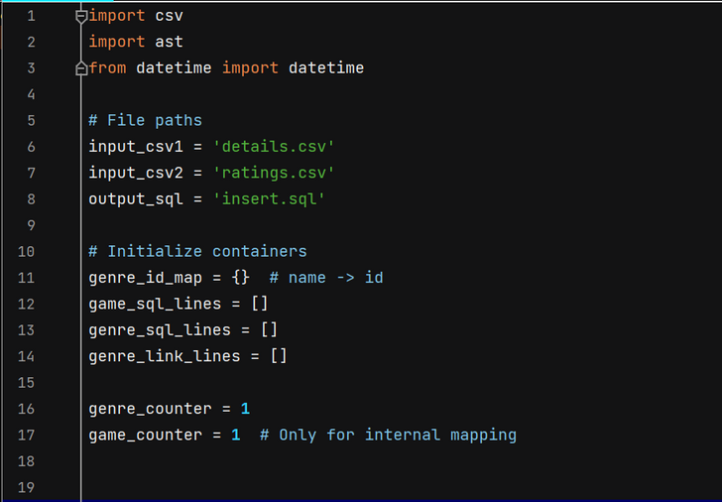
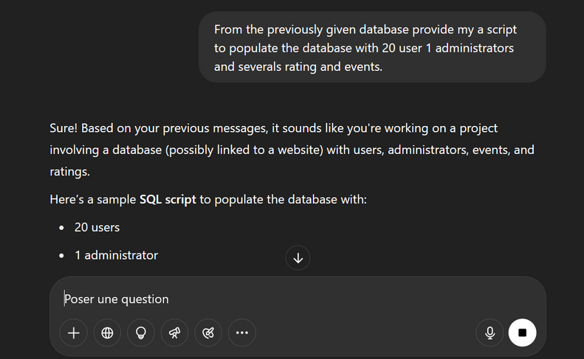
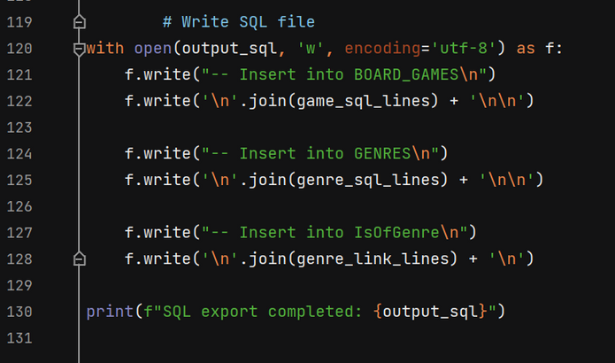
Population of the Database
Fetching Data from the csv files with a python script
Create data for the rest with chatgpt prompt

Slide 12
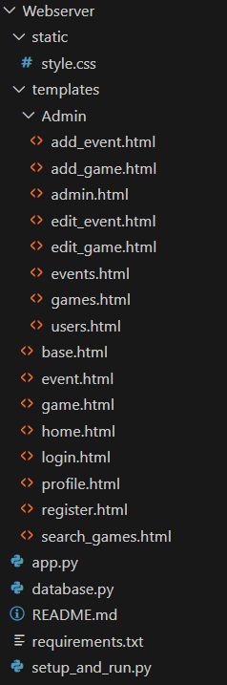


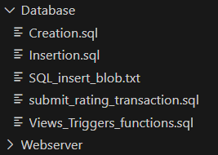

The website backend

Slide 13
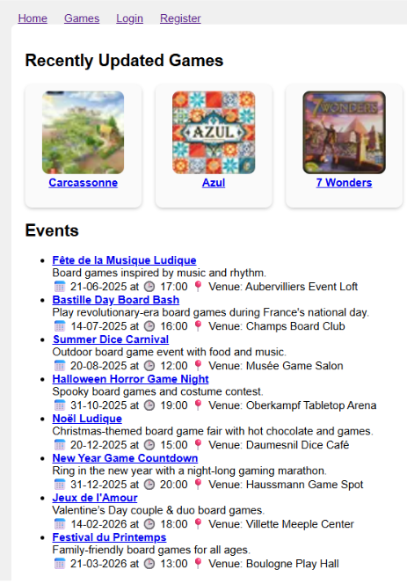
The website frontend

Slide 14

THANK YOU

